Slide 2

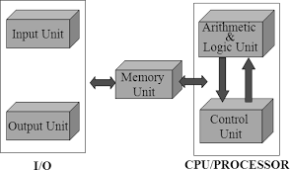
Functional units

Slide 3
Instructions (Machine Instructions)/Data: transfer of information and specify ALU operation
Program.
This is the fundamental principle of modern computers.
stored in the memory.
The processor fetches the instructions.
This stored program completely controls the computer's actions
Data
Definition: Numbers and encoded characters that the instructions use as operands (the items being operated on).
General Use: Often used broadly to mean any digital information.
Program as Data
Example: Compiling

Slide 4
The Need for Encoding
digital circuits that operate in only two stable states: ON and OFF.
numbers, characters, and instructions—to be translated into a format that uses only two values.
Bit
Encoding
Encoding Numbers
Positional Binary Notation
Binary-Coded Decimal (BCD)
Encoding Characters: ASCII, EBCDIC(Extended Binary-**C**oded Decimal Interchange Code)

Slide 5





Input Unit

Slide 6
Memory Unit
store programs and data
categorized into two classes: primary storage and secondary storage.
Primary Storage (RAM)
fast memory that operates at electronic speeds.
Programs must reside here while they are being executed.
Storage Cells and Bits.
Words.
Word Length: 16 to 64 bits.
Addressing

Slide 7
Random-Access Memory (RAM)
Memory where any location can be reached in a short and fixed amount of time after specifying its address.
Memory Access Time: The time required to access one word. This time is fixed regardless of the word's location.
For modern RAM, it typically ranges from a few nanoseconds (ns) to about 100 ns.
Memory Hierarchy
three or four levels of semiconductor RAM units with varying speeds and sizes.
Caches: Small, fast RAM units that are tightly coupled with the processor,
Main Memory: The largest and slowest unit in the primary storage hierarchy.
Secondary Storage
storing large amounts of data and many programs, especially for information that is accessed infrequently.
Characteristics: It is generally cheaper and slower than primary storage.
Examples

Slide 8
Arithmetic and Logic Unit (ALU)
most of the computer's operations are actually performed.
It is a critical component of the processor.
Function of the ALU
Execution of Operations
Data Flow Example (Addition)
Registers:When operands are brought into the processor for an operation, they are temporarily stored in special, high-speed storage elements
store one word of data
registers are faster than the access times
Control Unit + ALU = faster
control a number of external devices, such as keyboards, displays, storage disks, sensors, and mechanical controllers.

Slide 9
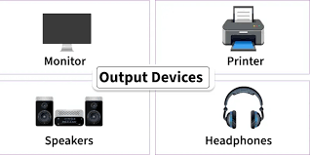
Output Unit

Slide 10
Control Unit
Coordination: The primary task is to coordinate the operation of the memory, arithmetic and logic (ALU), input, and output units.
Control Signals: It functions by sending control signals to the other units and sensing their states.

Slide 11
BASIC OPERATIONAL CONCEPTS
Instruction Execution
Single Instruction Example: Add LOCA, R0
Action
Effect on Data
Steps Required:
Fetch Instruction: The Add LOCA, R0 instruction is fetched from memory into the processor.
Fetch Operand: The operand at memory location LOCA is fetched.
ALU Operation: The fetched operand is added to the contents of R0.
Store Result: The sum is stored back into register R0.

Slide 12
Two-Instruction Sequence (Load/Store Architecture)
Load LOCA, R1
Add R1, R0

Slide 13
Processor Registers and Communication with Memory
Register | Full Name | Function
IR | Instruction Register | Holds the instruction currently being executed. Its output goes to the control circuits to generate timing signals.
PC | Program Counter | Contains the memory address of the next instruction to be fetched. It is automatically updated (incremented) during the execution of an instruction.
R0 through R(n-1) | General-Purpose Registers | Used to temporarily store operands and results. (The example instructions use R0 and R1).

Slide 14
Memory Communication Registers
Register | Full Name | Function
MAR | Memory Address Register | Holds the address of the memory location that is to be accessed (read from or written to).
MDR | Memory Data Register | Holds the data being written into or read out of the addressed memory location.

Slide 15
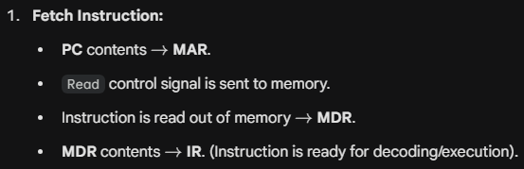
Typical Operating Steps (Instruction Cycle)
Program execution starts by setting the PC to point to the first instruction's address. The process then cycles through these steps

Slide 16
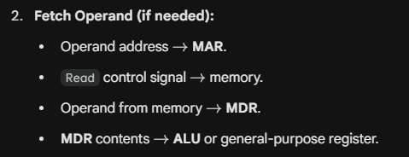
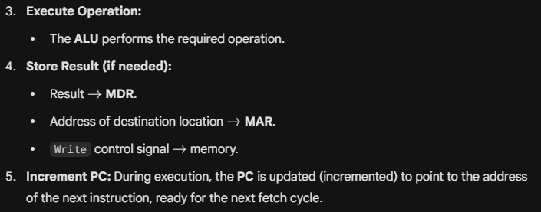

Slide 17
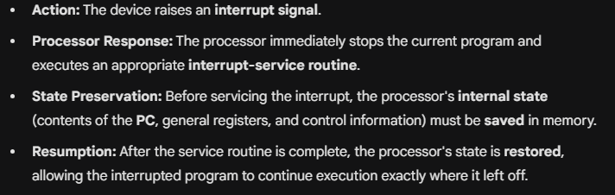
Interrupts
Normal program execution can be preempted by an interrupt, which is a request for service from an external device (like an I/O device or a monitoring device) that requires immediate attention.

Slide 18
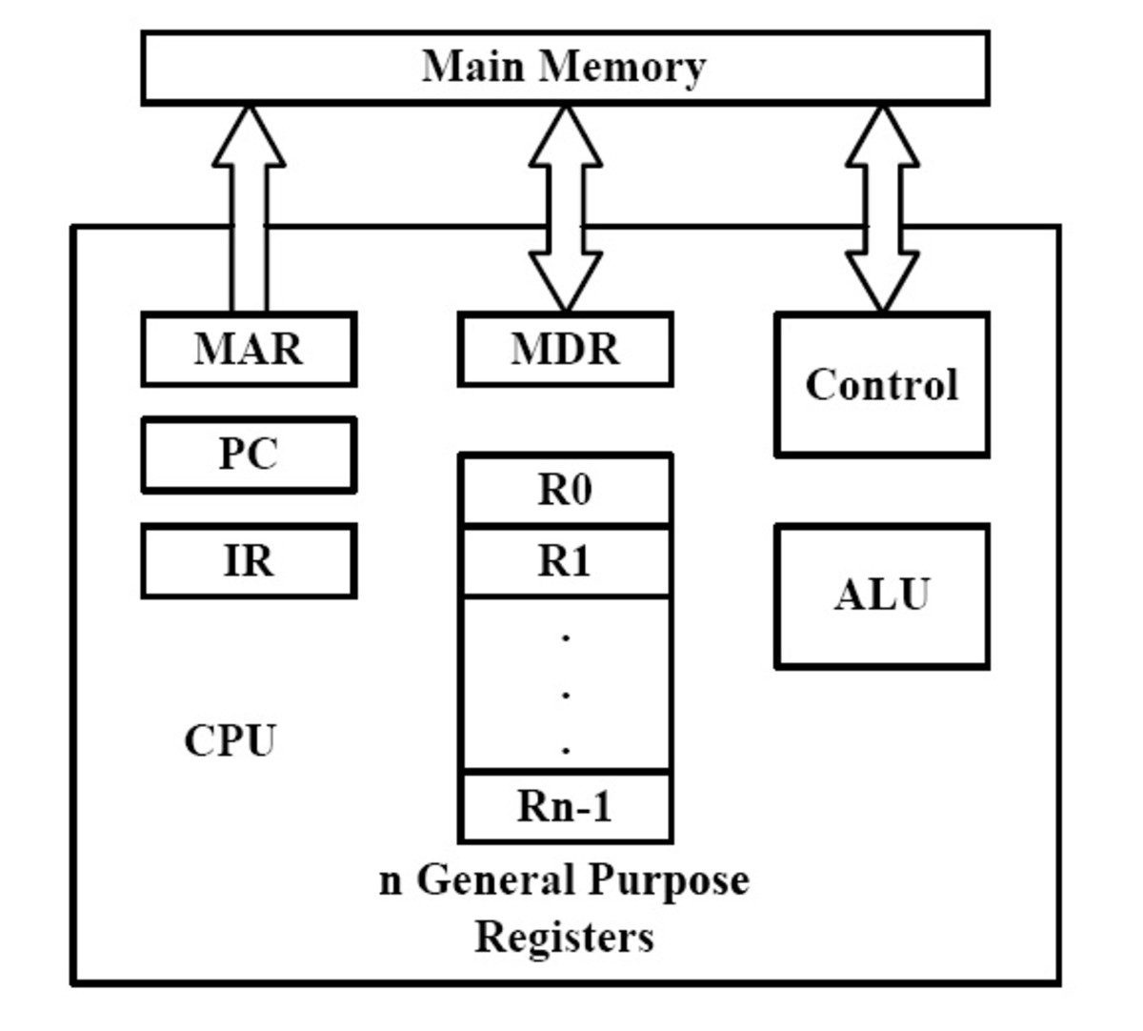

Slide 19
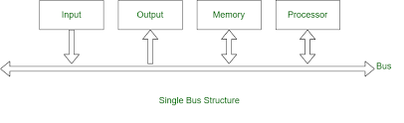
Bus Structures

Slide 20
Characteristics of a Bus
Parallel Transfer: To achieve reasonable speed, a computer is organized so that all units can handle one full word of data at a given time. When a word is transferred, all its bits are transferred in parallel (simultaneously) over many wires, with one bit per line.
Bus Lines: In addition to the lines that carry the data, a bus must also have lines for address and control purposes

Slide 21
Single-Bus Structure
Concept: All functional units (Input, Output, Memory, Processor) are connected to a single bus.
Limitation: The bus can be used for only one transfer at a time.
Active Units: Only two units can actively use the bus at any given time.
Virtues: The main virtue of the single-bus structure is its low cost and its flexibility for attaching peripheral devices.

Slide 22
Multiple-Bus Structures
Advantage: Systems with multiple buses achieve more concurrency by allowing two or more transfers to be carried out at the same time.
Trade-off: This leads to better performance but at an increased cost.

Slide 23
Dealing with Speed Differences (Buffer Registers)
The devices connected to a bus vary widely in speed. Memory and processor ->electronic speeds, keyboards and printers are relatively slow.
Example (Processor to Printer):
The processor sends an encoded character over the bus to a printer buffer.
The transfer to the electronic buffer is quick.
the printer starts printing without further processor intervention.
The bus and the processor are released for other activity.
Benefit: Buffer registers allow the processor to switch rapidly between different devices, interweaving its processing activity with data transfers involving several I/O devices.

Slide 24
Performance
how quickly it can execute programs.
The speed -> three factors: the hardware, the machine instruction set, and the compiler
Measuring Performance
The overall time required to execute a program is known as the elapsed time.
This time is affected by the speed of all components in the system, including the processor, the disk, and the printer.
Processor Time: To discuss the performance of just the processor, only the periods during which the processor is actively involved are considered. The processor time is the sum of these active periods.

Slide 25
The Role of Cache Memory
To minimize the time spent transferring instructions and data between the main memory and the processor, a cache memory is used.
Speed Disparity: The internal speed of performing basic instruction processing on the processor chip is very high, but it is considerably faster than the speed at which instructions and data can be fetched from the main memory.
Cache Placement: The cache is a relatively small memory unit that can be fabricated on the same integrated circuit chip as the processor.
Operation:
As execution begins, instructions and data are in the main memory.
Instructions and required data are fetched into the processor, and a copy is placed in the cache.
If the same instruction or data item is needed a second time, it is read quickly directly from the cache.

Slide 26
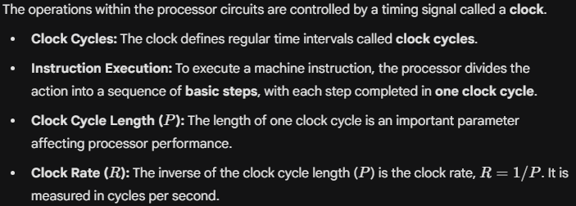
Processor Clock

Slide 27
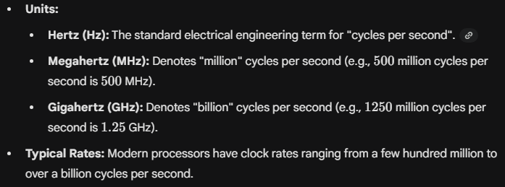

Slide 28
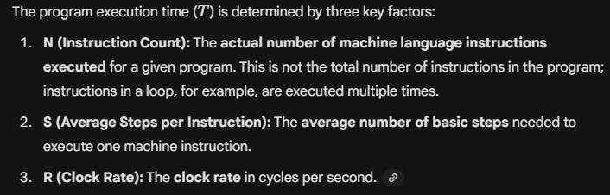
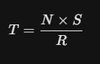
Basic Performance Equation
The focus is on the processor time component (T) of the total program execution time

Slide 29
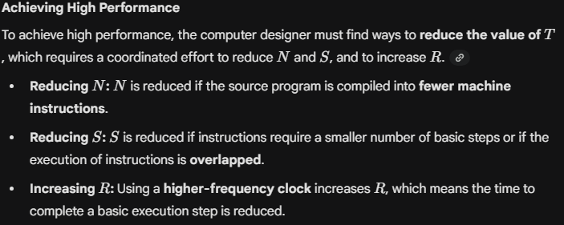

Slide 30
Pipelining and Superscalar Operation
A substantial improvement in processor performance can be achieved by executing successive instructions in an overlapped fashion, which lowers the effective value of S(average steps per instruction) in the performance equation
Superscalar Operation
Concept: A higher degree of concurrency is achieved by implementing multiple instruction pipelines within the processor.
Mechanism: This utilizes multiple functional units to create parallel paths through which different instructions can be executed simultaneously.

Slide 31
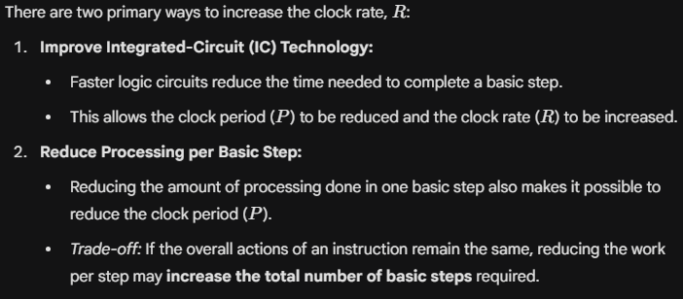
Clock Rate (R)

Slide 32
Instruction Set: CISC and RISC
The design of a processor's instruction set is a key factor affecting the performance parameters N (instruction count) and S (average steps per instruction) in the equation T = (N x S) / R.
Instruction Type | Characteristics | Effect on N and S
Simple Instructions | Require a small number of basic steps to execute. | Large $N$ (many instructions needed for a task), Small $S$ (few steps per instruction).
Complex Instructions | Perform more complex operations, involving a large number of steps. | Lower $N$ (fewer instructions needed for a task), Larger $S$ (many steps per instruction).

Slide 33
CISC vs. RISC
The two different design philosophies based on instruction complexity are:
RISC (Reduced Instruction Set Computers): Refers to processors with simple instructions.
CISC (Complex Instruction Set Computers): Refers to processors with more complex instructions.
These terms describe design principles and techniques that result from many trade-offs, and do not necessarily correspond to clearly defined classes of processors.

Slide 34
Compiler
The compiler is responsible for translating a high-level language program into a sequence of machine instructions.
Role in Performance: The compiler significantly impacts the performance parameter N.
To reduce N, a suitable machine instruction set and a compiler that makes good use of it are necessary.
Compiler-Processor Link: Although a compiler may appear to be a separate entity, a high-quality compiler must be closely linked to the processor architecture.

Slide 35
Memory Locations and Addresses
Instructions, number operands, and character operands are all stored in a computer's memory. The memory is structured as millions of storage cells, with each cell capable of storing one bit of information (a value of 0 or 1).
Words and Word Length
Word
Word Length (n):
Byte: A unit of 8 bits.
Example (32-bit word):

Slide 36
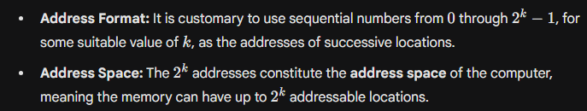
Memory Addressing and Address Space
Accessing a single item of information in memory, whether a word or a byte, requires distinct names or addresses for each location.

Slide 37
Byte Addressability
Computer memory is organized around three basic information quantities: the bit, the byte, and the word.
The most practical and common assignment in modern computers is to have successive addresses refer to successive byte locations in memory. This convention is called byte-addressable memory.
Byte Addresses: Byte locations have addresses 0, 1, 2, 3, and so on.
Word Addresses: If the word length is 32 bits, a word consists of four bytes. Consequently, successive words are located at addresses 0, 4, 8,.

Slide 38
Big-Endian and Little-Endian Assignments
Convention | Description | Address Assignment
Big-Endian | Lower byte addresses are used for the more significant bytes (the leftmost bytes) of the word. | Lower addresses store the bytes with the greater numerical weight (powers of 2).
Little-Endian | Lower byte addresses are used for the less significant bytes (the rightmost bytes) of the word. | Lower addresses store the bytes with the lesser numerical weight.

Slide 39
Word Alignment
Words are said to have aligned addresses when they begin at a byte address that is a multiple of the number of bytes in a word.
Accessing Numbers, Characters, and Character Strings
Numbers: A number usually occupies one word and is accessed by specifying its word address.
Characters: Individual characters are accessed by their byte address.
Character Strings: Strings are often of variable length. The start of the string is indicated by giving the address of the byte containing the first character, and successive byte locations contain successive characters.

Slide 40
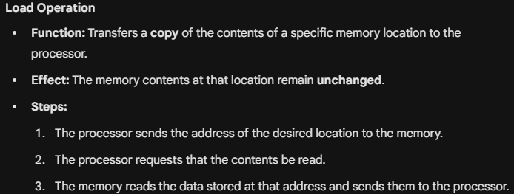
Memory Operations
Both program instructions and data operands are stored in the memory. Consequently, two fundamental operations are necessary for moving information between the memory and the processor: Load (or Read/Fetch) and Store (or Write).

Slide 41
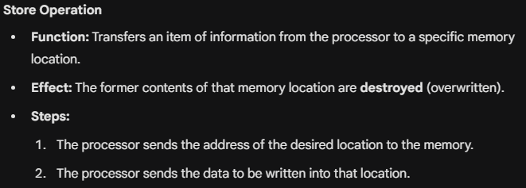

Slide 42
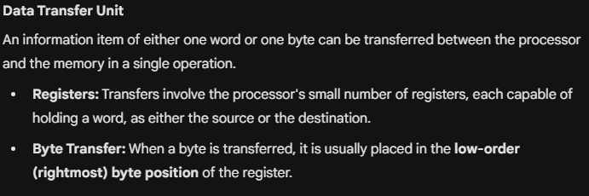

Slide 43
Instructions and Instruction Sequencing
The tasks carried out by a computer program are a sequence of small steps (e.g., adding numbers, reading from a keyboard). A computer must have instructions capable of performing four fundamental types of operations:
Data transfers between the memory and the processor registers.
Arithmetic and logic operations on data.
Program sequencing and control.
I/O transfers (Input/Output).

Slide 44
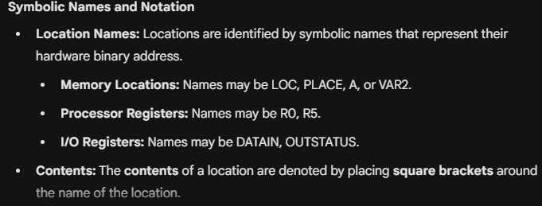
Register Transfer Notation (RTN)
Register Transfer Notation (RTN) is a symbolic way to describe the transfer of information from one location in the computer to another. These locations can include memory locations, processor registers, or registers in the I/O subsystem.

Slide 45
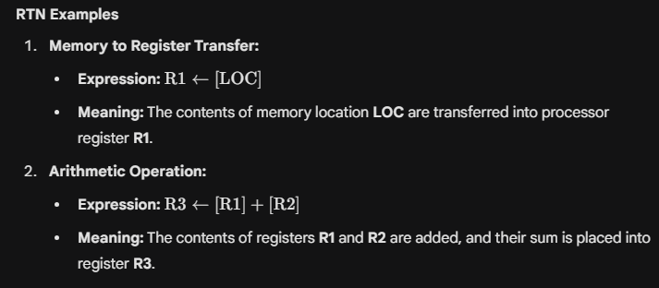

Slide 46
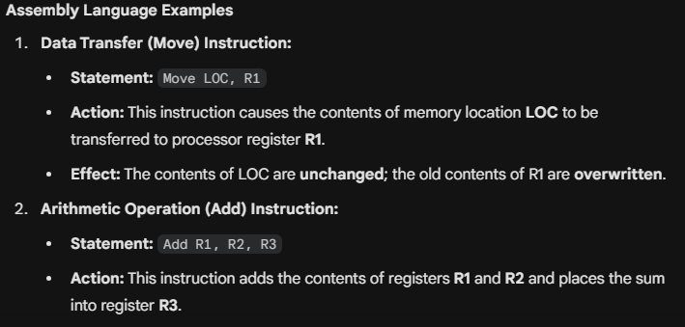
Assembly Language Notation
Assembly language notation is used to represent machine instructions and programs in a way that is easier for humans to read than binary machine code.

Slide 47
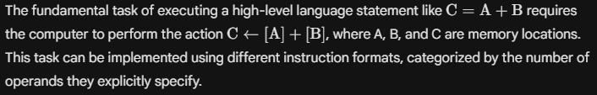
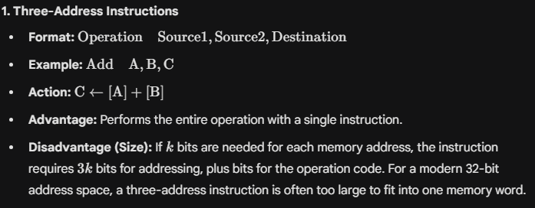
Basic Instruction Types

Slide 48
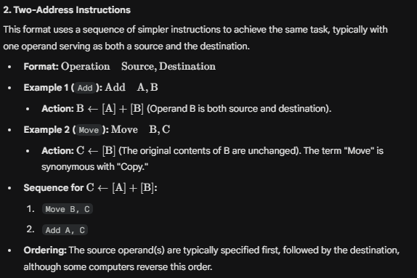

Slide 49
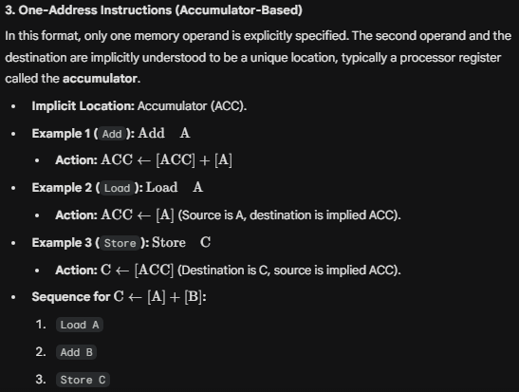

Slide 50
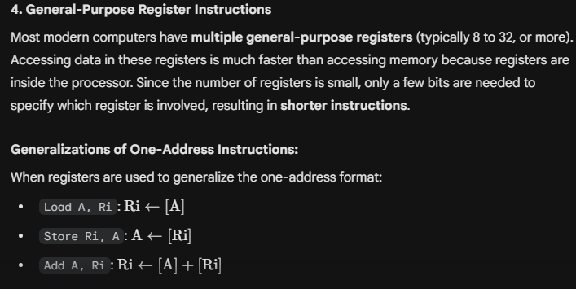

Slide 51
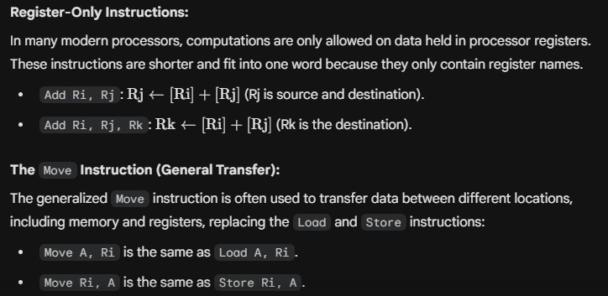

Slide 52
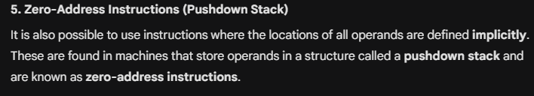

Slide 53
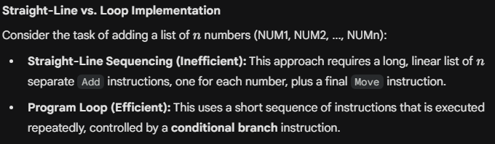
Branching
the concept of branching as a means of controlling program flow, particularly to implement program loops rather than using long sequences of instructions.

Slide 54
Branch instructions load a new value (the branch target address) into the Program Counter (PC).
Result: The processor fetches and executes the instruction at this new address, instead of the instruction that sequentially follows the branch.
Conditional Branch: This type of instruction causes a branch only if a specified condition is satisfied.
If the condition is satisfied, the PC is loaded with the branch target address (e.g., LOOP).
If the condition is not satisfied, the PC is incremented normally, and the next instruction in the sequential order is fetched.

Slide 55
Condition Codes
The information is stored in individual bits called condition code flags, which are typically grouped in a special processor register called the condition code register or status register.
Individual flags are set to 1 or cleared to 0 based on the outcome of the last operation.
Flag | Name | Condition | Purpose
N | Negative | Set to 1 if the result is negative. | Indicates the sign of the result of an arithmetic/logic operation.
Z | Zero | Set to 1 if the result is 0. | Indicates if the result is zero.
V | Overflow | Set to 1 if arithmetic overflow occurs. | Allows the programmer to test for results outside the representable range.
C | Carry | Set to 1 if a carry-out results from the operation. | Facilitates multiple-precision arithmetic (operations on operands longer than the word length).

Slide 56
Addressing Modes
Programs operate on data organized in various data structures (like lists, arrays, queues) within the computer's memory.
When a high-level language program is translated into assembly language, the compiler must implement these constructs using the instruction set facilities.
The different ways in which the location of an operand is specified in an instruction are referred to as addressing modes.

Slide 57

Implementation of Variables and Constants
1. Register Mode (For Variables)
The operand is the contents of a processor register.
2. Absolute Mode (Direct) (For Variables)
The operand is in a memory location, and the address of this location is given explicitly in the instruction.
3. Immediate Mode (For Constants)
The operand is the constant value itself, given explicitly in the instruction.

Slide 58
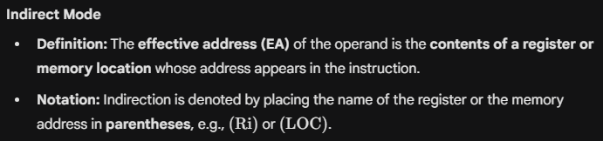
Indirection and Pointers
In the addressing modes discussed so far, the instruction did not explicitly provide the operand or its address.
Instead, it provides information from which the final memory address of the operand—known as the effective adderss (EA).

Slide 59
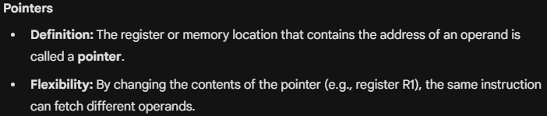
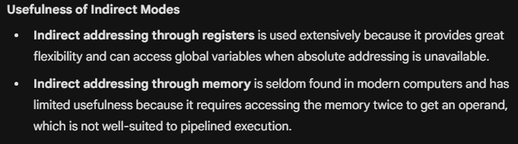

Slide 60
Indexing and Arrays
The Index mode provides the flexibility needed for accessing elements within lists and arrays.

Slide 61
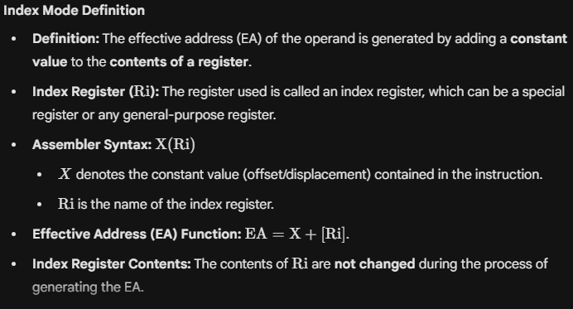

Slide 62
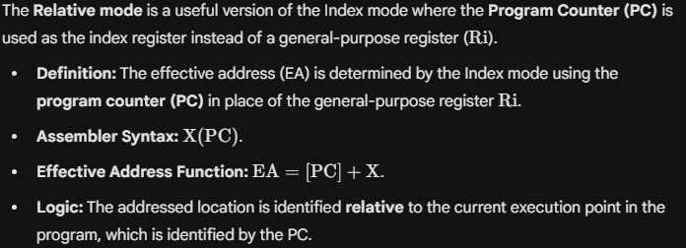
Relative Addressing

Slide 63
Additional Modes
In addition to the five basic modes (Immediate, Register, Absolute, Indirect, and Index), two additional modes are provided to efficiently access data items in successive memory locations.
1. Autoincrement Mode
2. Autodecrement Mode

